Slide 1

Capstone Project:
Patient-Specific Interpretable Disease Prediction using Molecular Subnetworks with Genomics data
Guided By: Dr. Giri Narasimhan
Mentor: Dr. Ananda M. Mondal
Team Members:
Sai Siva Kondapalli & Lakshmi Kammili

Slide 2
Table of contents
01
02
03
04
05
06
Problem
Data
Terminology
Genomic & Transcriptomic
Domain specific terms
Theme Paper
Methods
Results
Goal, Pipeline
GCNN & LRP

Slide 3
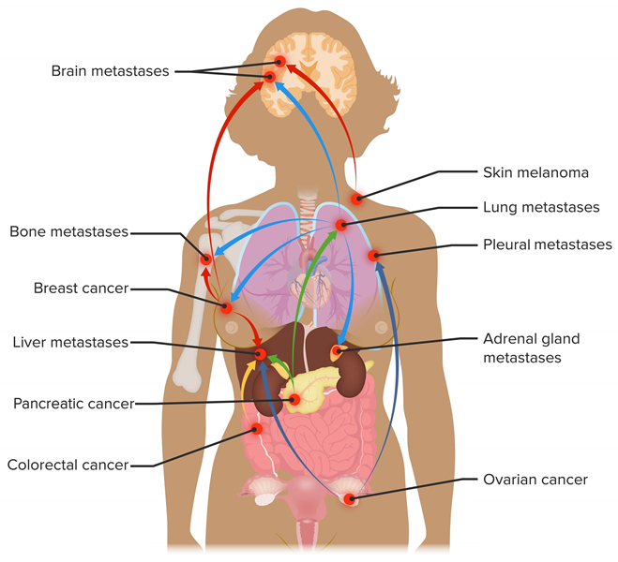
Problem: Cancer Metastasis
Focus: Metastasis in Breast Cancer
Differentiate metastatic and non-metastatic
Identify the biomarkers
https://compass.rauias.com/current-affairs/genome-sequencing-and-the-genome-india-project/
Notes:
Cancer is one of the leading causes of death worldwide. Breast cancers account for more than 40% of all cancer cases and deaths globally.
Here our focus is on metastasis in breast cancer.
Metastatic breast cancer is breast cancer that has spread from the original tumor in the breast to other parts of the body, such as the bones, lungs, liver or brain. This process is called metastasis and it happens when cancer cells break away from the primary tumor and travel through the blood.
In the United States, 6% of women have metastatic breast cancer when they are first diagnosed. This means that 1 in 3 women diagnosed with breast cancer will become metastatic. 90–95% of breast cancer patients are diagnosed in early stages, but 20–30% of these patients become metastatic. Metastatic breast cancer is incurable.
First, we are going to classify if patients have metastasis or not.
Second, we would try to identify bio markers that are causing metastasis.

Slide 4
Importance
Metastasis
Treatment Planning and Decisions
Prognosis and Survival Rates
Biomarkers
Personalized Medicine
Early Detection and Diagnosis
https://compass.rauias.com/current-affairs/genome-sequencing-and-the-genome-india-project/
Notes:
It can help us to find biomarkers that can predict the metastasis potential of cancer cells and the prognosis of patients.
It can help to design personalized and targeted therapies that can inhibit or reverse the metastatic process and improve the survival and quality of life of patients.

Slide 5
Data
01
GEO_HG_PPI
Contains the gene expression data of breast cancer patients
969 samples & 6888 features (protein encoding genes)
Patient
GSM615697 | GSM177887 | ……… | Probe
13.56382858 | 13.89274239 |  | RPL41
13.32145179 | 14.02797291 |  | EEF1A1
6.074499 | 5.946836433 |  | MSTN
Protein coding Gene
https://owncloud.gwdg.de/index.php/s/l2zzOtscXAwS8de
Notes:
The data contains 969 samples and 6888 features (protein-encoding genes). The samples are labeled as "Patient" and the features are labeled as "Probe". The values in the table represent the expression levels of each gene in each sample.
Gene expression data can be used to identify genes that are differentially expressed between different groups of samples.

Slide 6
Data
02
HPRD_PPI
contains the adjacency matrix with the 6888 genes in the file GEO_HG_PPI.csv
Dimension : 6888 * 6888
Probe | RPL41 | EEF1A1 | ……… | MSTN
RPL41 | 0 | 0 |  | 0
EEF1A1 | 0 | 0 | 1 | 0
MSTN | 0 | 0 |  | 0
Protein coding
Gene
Protein coding Gene
https://owncloud.gwdg.de/index.php/s/l2zzOtscXAwS8de
Notes:
It is an adjacency matrix used to represent interactions between protein-coding genes. Each row and column in the matrix corresponds to a protein-coding gene. The matrix is usually symmetric since the interaction between gene A and gene B is the same as between gene B and gene A.
0 Is representing the absence of interaction
1 Is representing the presence of interaction

Slide 7
Data
03
Labels_GEO_HG
Metastsis -1 (393) & Non-Metastasis – 0 (576)
Patient
GSM615697 | GSM177887 | ……… | GSM615775
1 | 1 |  | 0
https://owncloud.gwdg.de/index.php/s/l2zzOtscXAwS8de
Notes:
Labeled data of patient with metastasis and non metastasis. Metastasis:1 ; non- metastasis:0

Slide 8
Data
04
GENOMIC DATA
Copy Number Variation ( CNV ) : 767 sample & 24775 genes
-2,-1,0,1,2: homozygous deletion, single copy deletion, no change, low-amplification, high-amplification
TCGA-3C-AAAU-01 | TCGA-3C-AALI-01 | ……… | Gene Symbol
0 | -1 |  | ACAP3
0 | -1 |  | ACTRT2
-1 | -1 |  | WASIR1
Patient
Protein coding Gene
https://xenabrowser.net/datapages/?dataset=TCGA.BRCA.sampleMap%2FGistic2_CopyNumber_Gistic2_all_thresholded.by_genes&host=https%3A%2F%2Ftcga.xenahubs.net&removeHub=https%3A%2F%2Fxena.treehouse.gi.ucsc.edu%3A443
Notes:
This dataset refers to a collection of data that describes the copy number status of specific genomic regions across a set of samples.
Copy Number Variation ( CNV ) : 767 samples & 24775 genes
−2 = (how·mow·zai·guhs )Homozygous Deletion: This means that both copies of the DNA segment have been deleted or lost from the cell's genome. It indicates a complete absence of that particular DNA segment.
−1 = (hemi·zai·guhs )Hemizygous Deletion: In this case, only one copy of the DNA segment is deleted or lost from the cell's genome. This typically happens when one copy of the gene is deleted while the other remains intact.
0 = Neutral / No Change: This indicates that there's no change in the copy number compared to the normal diploid state. The cell has the usual two copies of the DNA segment.
1 = Gain: Here, there's an increase in the number of copies of the DNA segment. Instead of the usual two copies, there are three copies present in the cell.
2 = High-Level Amplification: This implies a significant increase in the number of copies of the DNA segment. Instead of the usual two copies, there are now four or more copies present in the cell. High-level amplification often indicates an abnormal multiplication of that particular DNA segment.

Slide 9
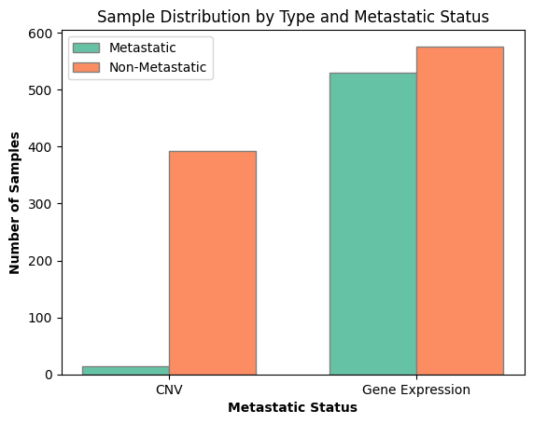
Data Summary

Slide 10
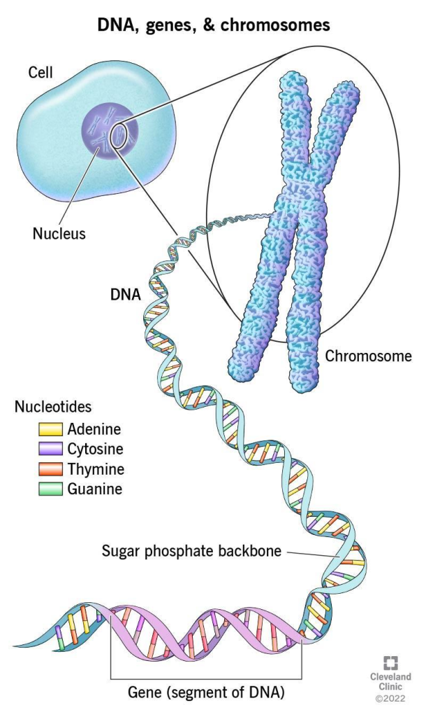
Hierarchical Genome Organisation
https://compass.rauias.com/current-affairs/genome-sequencing-and-the-genome-india-project/
Notes:
Cell:
The basic structural and functional unit of all living organisms, containing specialized structures and molecules that enable life-sustaining processes such as metabolism, growth, and reproduction.
Nucleus:
The nucleus is like the control center of a cell in our body. It's like a command center that holds all the instructions (DNA) needed to build and operate the cell, orchestrates gene expression, and regulates cellular activities through the control of transcription and RNA processing.
DNA (Deoxyribonucleic Acid):
The molecule carrying genetic instructions for the development, functioning, growth, and reproduction of all known living organisms and many viruses, consisting of two long chains of nucleotides twisted into a double helix and typically found within the nucleus of a cell.
Chromosomes:
Chromosomes are the most macroscopic level of genome organization. They are thread-like structures made up of DNA and proteins.
In humans, there are 46 chromosomes arranged in 23 pairs. Each chromosome contains many genes, which are the functional units responsible for encoding proteins and controlling various cellular processes.

Slide 11
Terminology
Gene
Genomics
Gene expression
PPI (Protein-Protein Interaction)
Notes:
Gene: A segment of DNA that contains the instructions for building a specific protein or RNA molecule, and ultimately determines an organism's traits.
Genomics: The study of the entire genetic material (genome) of an organism, including the organization, function, and evolution of genes and non-coding sequences.
Gene Expression: The process by which information encoded in a gene is used to synthesize a functional gene product, such as proteins or RNA molecules.
PPI (Protein-Protein Interaction): The physical interaction between two or more proteins within a cell, which plays a crucial role in regulating various biological processes, including signal transduction, metabolic pathways, and cellular organization.

Slide 12
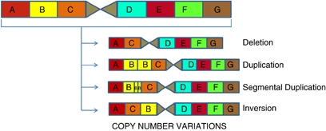
Terminology
CNV:
CNV: Copy number variation
Almal, S. H., & Padh, H. (2011, September 29). Implications of gene copy-number variation in health and diseases. Nature News. https://www.nature.com/articles/jhg2011108
Notes:
Copy Number Variation (CNV) refers to differences in the number of copies of specific DNA segments among individuals, which can influence genetic traits and susceptibility to diseases.

Slide 13
Goal!
Classifying Metastatic or Non Metastatic
Identify Biomarkers
Make deep learning algorithm interpretable
Notes:
They want to make a deep-learning algorithm’s decision or prediction explainable and use it to find the biomarkers that are causing the disease

Slide 14
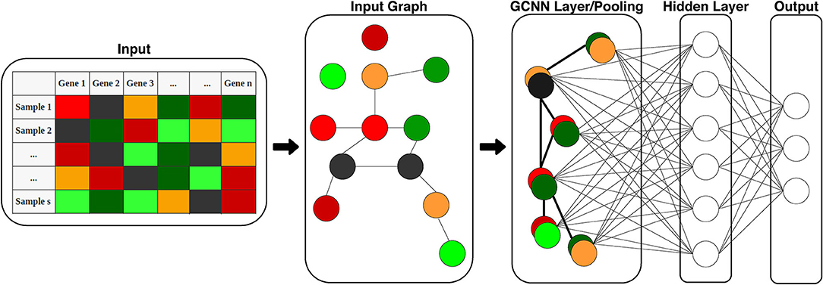
Methods
Classification: GCNN
Graph Convolution Neural Network
Nodes
Edges
Fig 1 : GCNN
Ramirez, R., Chiu, Y., Hererra, A., Mostavi, M., Ramirez, J., Chen, Y., Huang, Y., & Jin, Y. (2020). Classification of cancer types using graph convolutional neural networks. Frontiers in Physics, 8. https://doi.org/10.3389/fphy.2020.00203

Slide 15
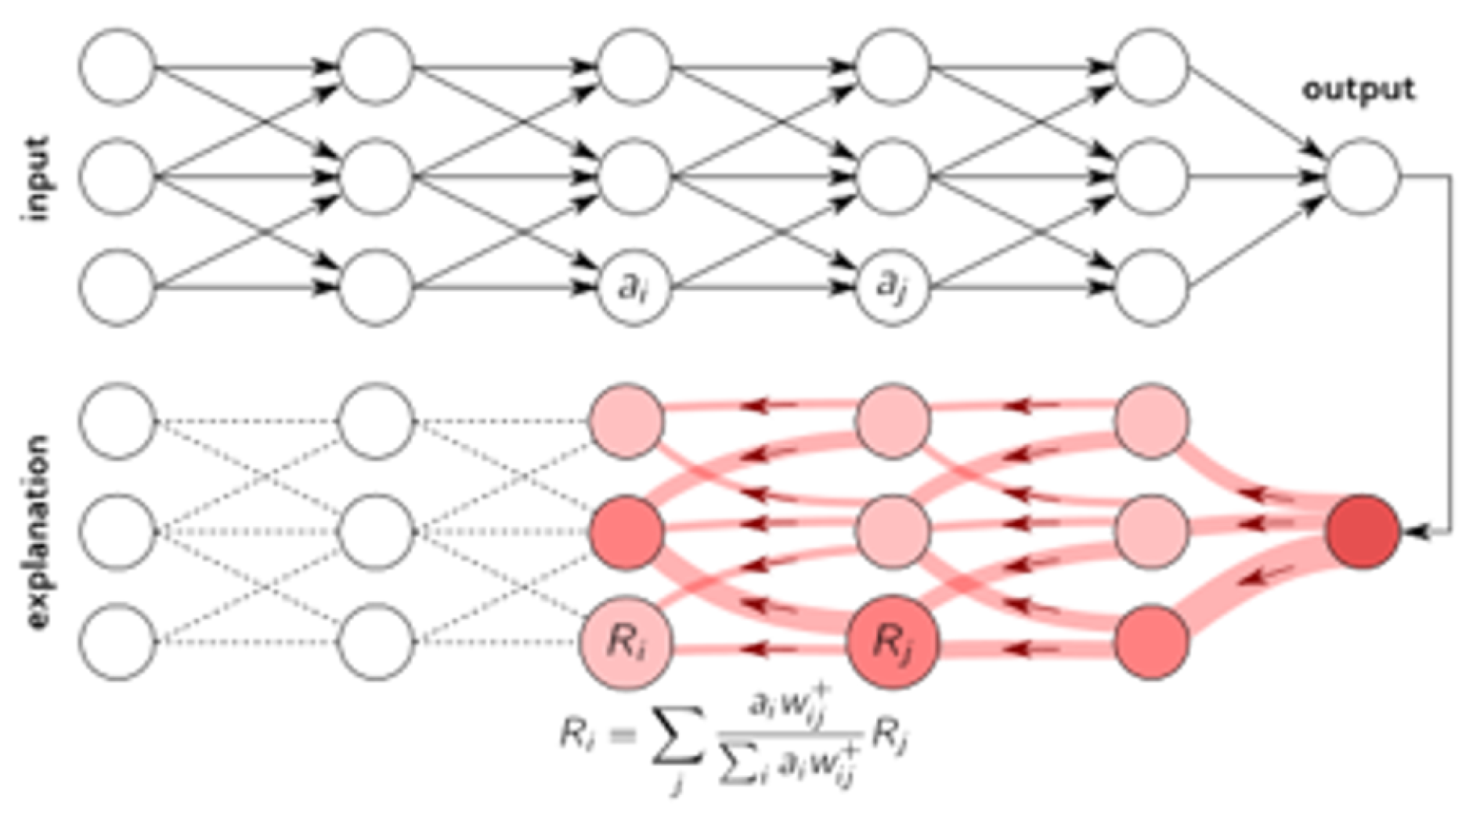
Methods
Sub Network : GLRP
Graph Layer-wise Relevance Propagation
Interpretable Technique
Relevance Score
Fig 2 : GLRP
Ullah, I., Rios, A., Gala, V., & McKeever, S. (2021). Explaining deep learning models for tabular data using Layer-Wise relevance propagation. Applied Sciences, 12(1), 136.

Slide 16
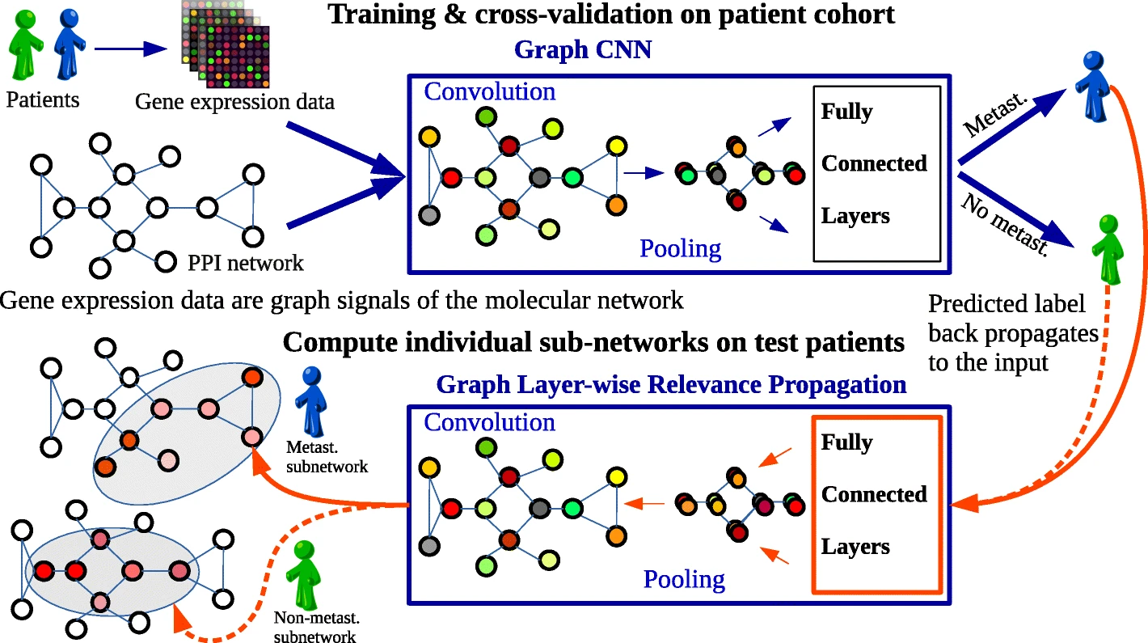
Pipeline : Theme Paper
https://genomemedicine.biomedcentral.com/articles/10.1186/s13073-021-00845-7/figures/1

Slide 17
Path 1 CNV dataset
Notes:
The main difference between SMOTE and oversampling techniques is that SMOTE generates synthetic samples using interpolation between existing minority samples, while oversampling replicates existing minority samples to balance the dataset.

Slide 18
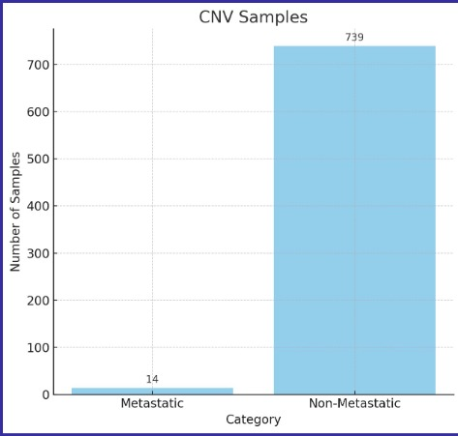
Data Summary

Slide 19
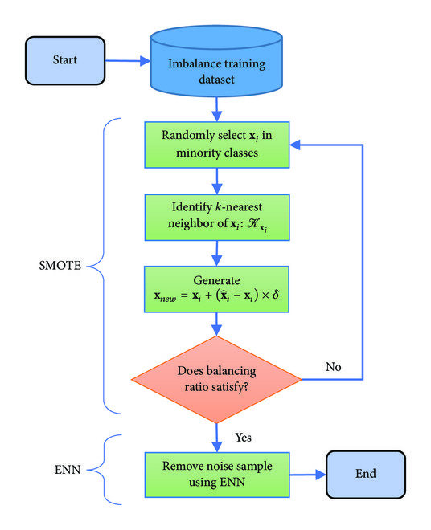
SMOTE ENN
https://www.researchgate.net/figure/The-flowchart-of-SMOTE-ENN-algorithm_fig5_334983308
Notes:
This is a combination of two techniques: SMOTE (Synthetic Minority Over-sampling Technique) and ENN (Edited Nearest Neighbors). SMOTE is used to over-sample the minority class in a dataset by creating synthetic examples, while ENN is an under-sampling technique that cleans up the over-sampled dataset by removing some instances. Together, they balance the dataset and improve the performance of classification algorithms.
Start with an Imbalanced Training Dataset: In many real-world scenarios, the data we want to learn from isn't evenly distributed. For example, in medical data, the number of healthy individuals (majority class) might be much higher than the number of sick individuals (minority class). This imbalance can make it hard for machine learning models to learn about the less common class.
SMOTE (Synthetic Minority Over-sampling Technique): This is a method used to create new, synthetic examples of the minority class so that the balance between classes is improved. Here’s how it works:
Randomly Select
�
�
x
i
​
in Minority Classes: First, the process begins by randomly choosing an example from the minority class.
Identify k-nearest Neighbors of
�
�
x
i
​
: For this selected example, the algorithm finds its 'k-nearest neighbors' — think of it as finding the most similar examples.
Generate Xnew A new example is created by taking the original example Xi and adding it to the difference between Xi and its neighbor Xki multiplied by a random number δ between 0 and 1. This creates a new point that is along the line between Xi and Xki, but not exactly at either point, hence it's "synthetic" or artificially made.
Does Balancing Ratio Satisfy?: This is a check to see if the new dataset created by SMOTE has a satisfactory balance between classes. If not, the SMOTE process may be repeated.
ENN (Edited Nearest Neighbors): After balancing the classes, sometimes the synthetic points can be noisy or too far from the true minority class examples. ENN helps by removing any of the synthetic examples that are too different from their neighbors. It's like proofreading the new synthetic points and removing any that don't fit well.
End: The process stops when the dataset has been sufficiently balanced and cleaned up. The resulting dataset should be more balanced than the original and better for training a machine learning model.

Slide 20
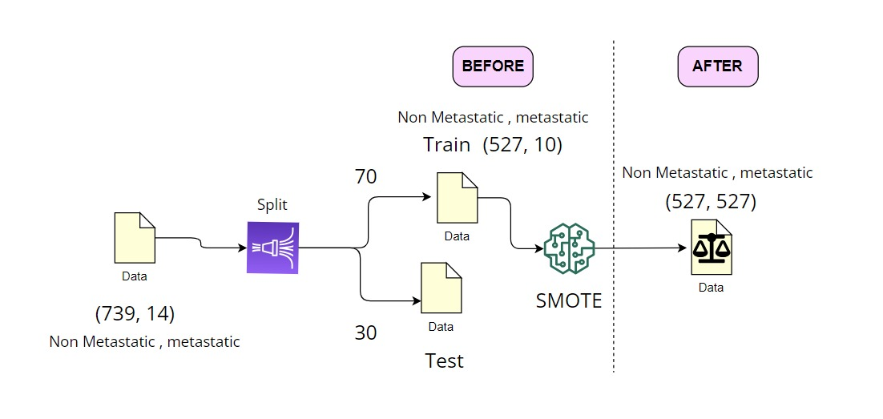
Re-Sampling

Slide 21
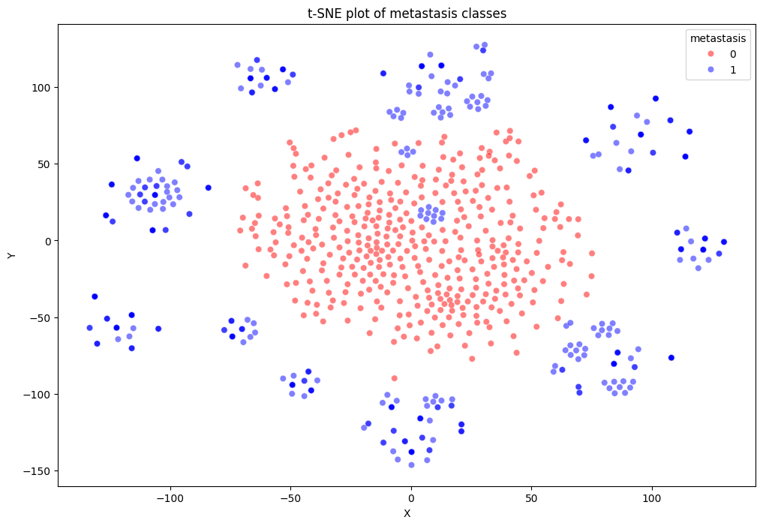
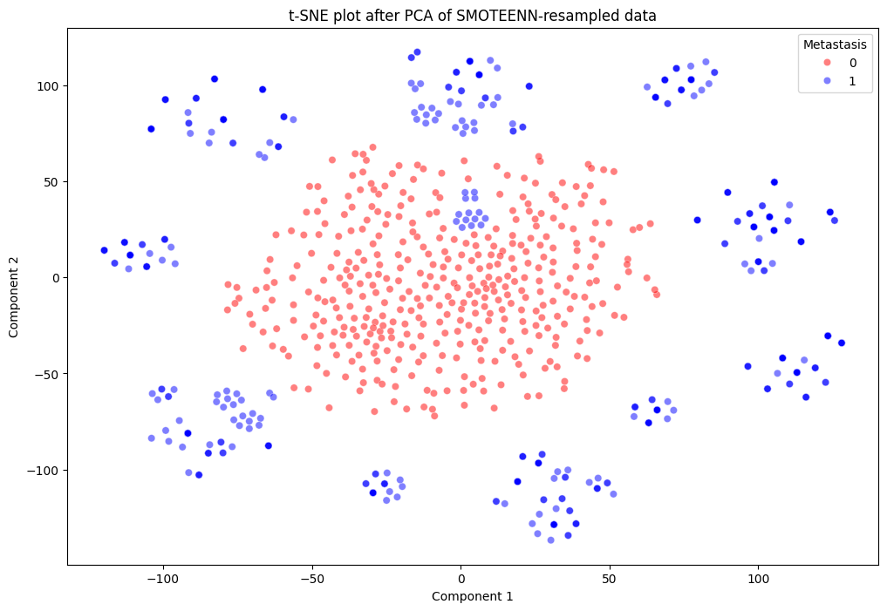
Resampled Data Plot
Notes:
t-SNE is a machine learning algorithm for visualization developed by Laurens van der Maaten and Geoffrey Hinton
It is particularly well suited for the visualization of high-dimensional datasets. It works by converting similarities between data points to joint probabilities and trying to minimize the Kullback-Leibler divergence between the joint probabilities of the low-dimensional embedding and the high-dimensional data.

Slide 22
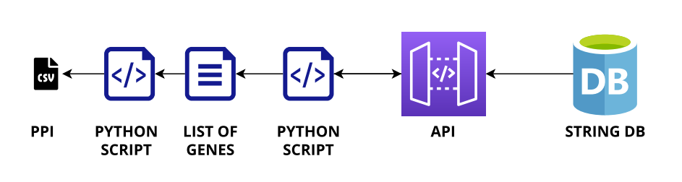
PPI Network Pipeline

Slide 23
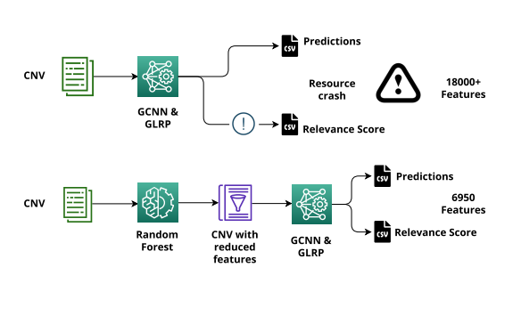
CNV Pipeline

Slide 24
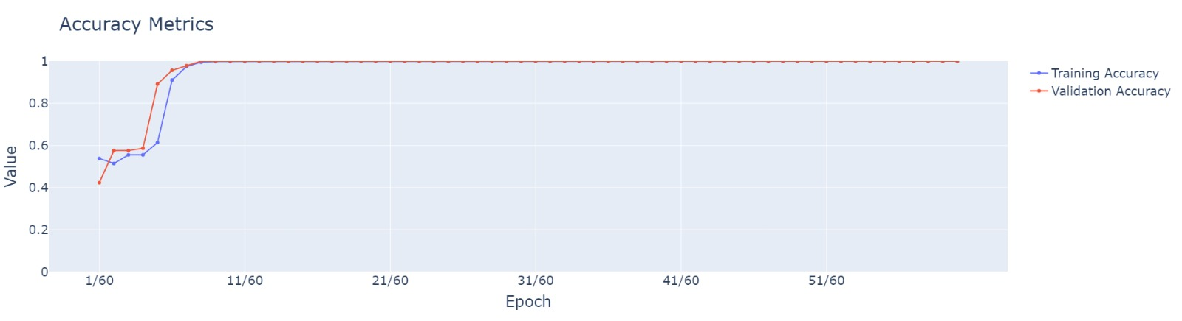
Accuracy Plot(GCNN)

Slide 25
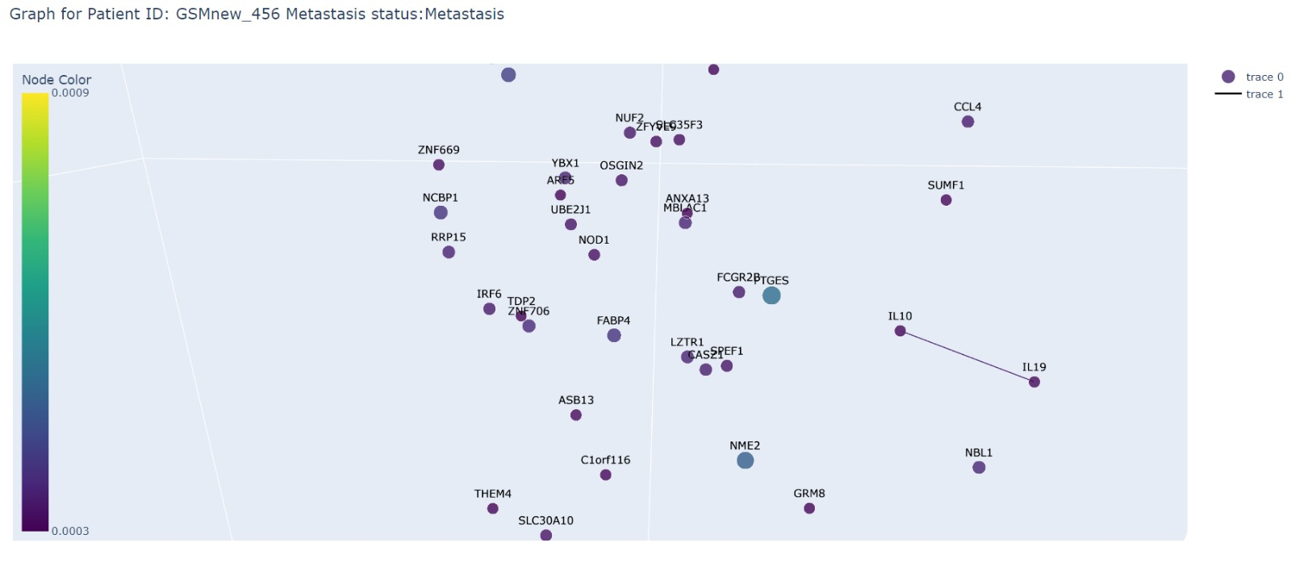
Sub Network

Slide 26
Path 2 Gene Expression Dataset

Slide 27
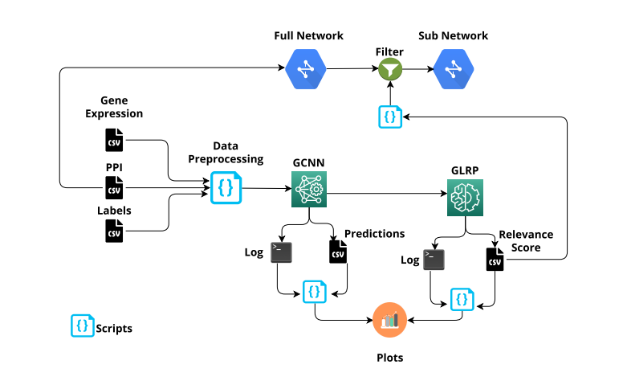
Pipeline: Our Approach

Slide 28
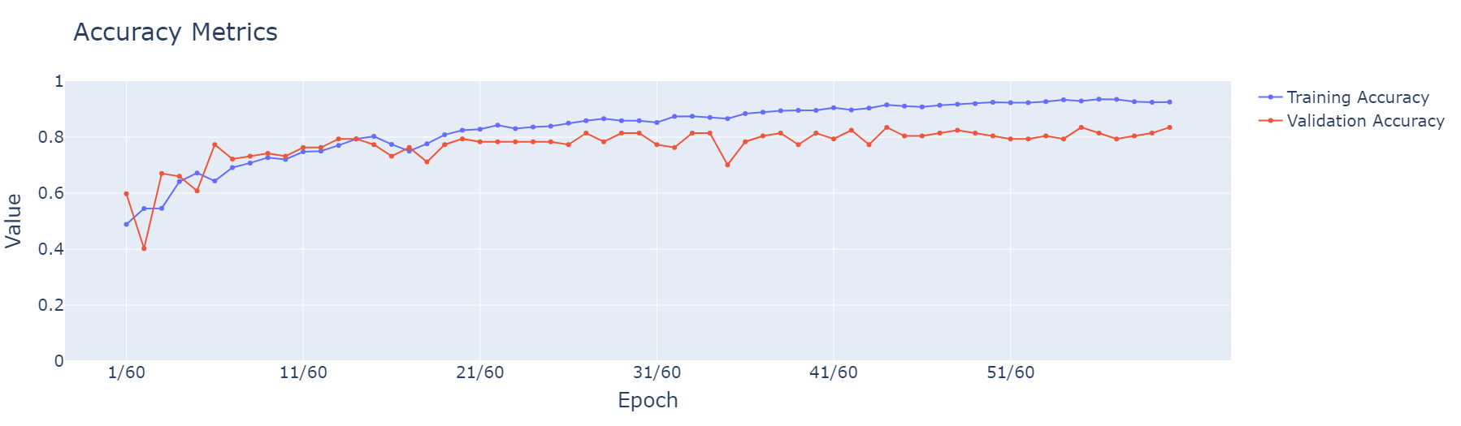
Accuracy Plot - GCNN

Slide 29
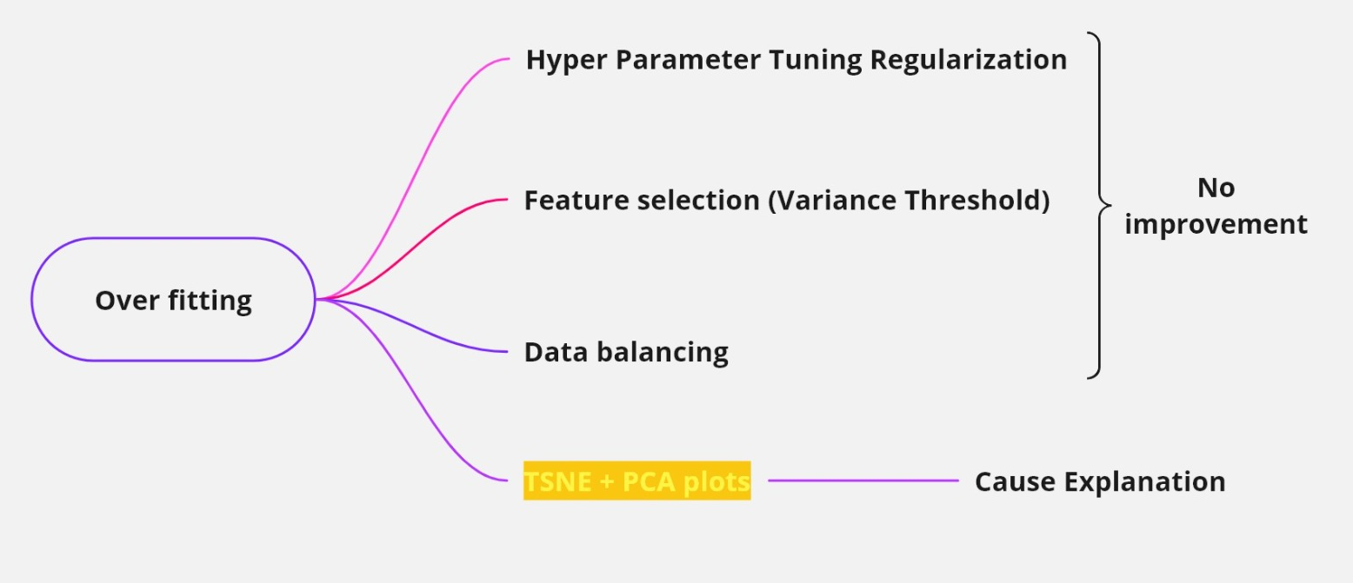
Overfitting

Slide 30
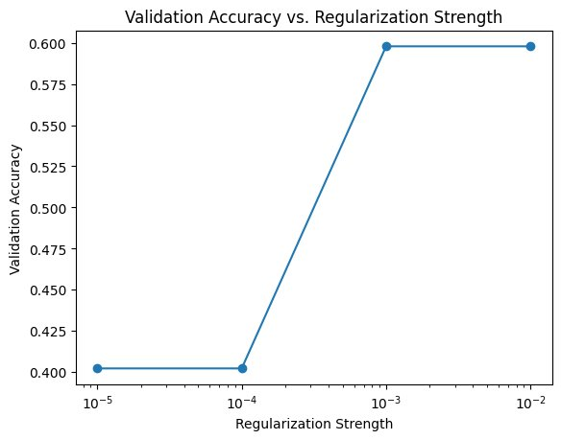
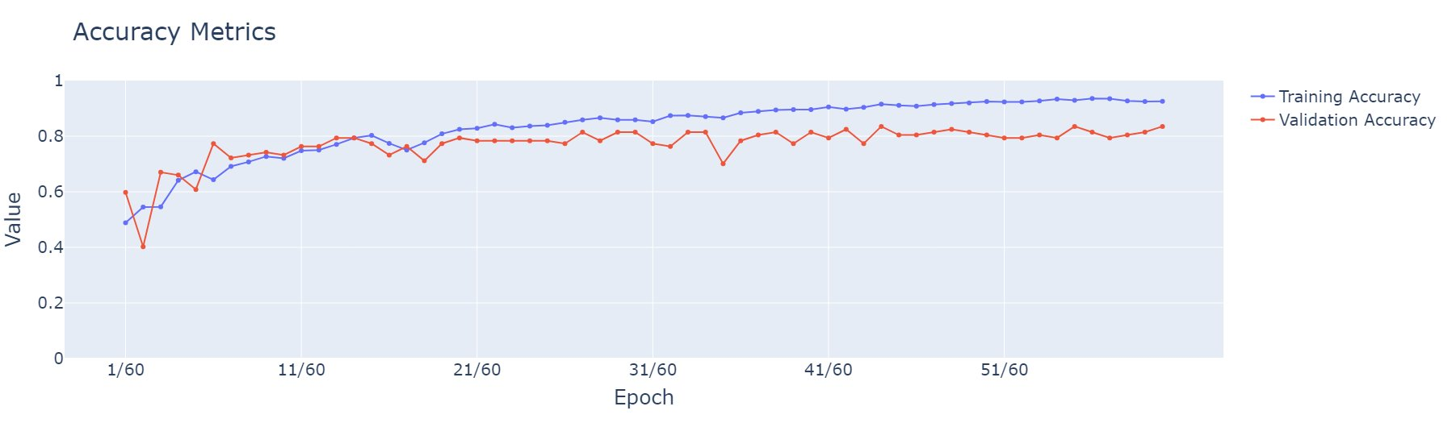
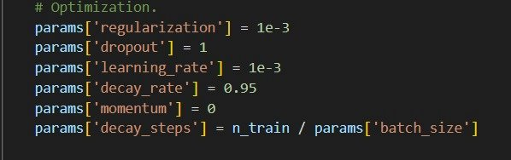
Overfitting(Regularization)
Notes:
Regularization
We employed hyperparameter tuning regularization to constrain the model's complexity and prevent it from memorizing the training data's noise. Still we could see there is overfitting issue.

Slide 31
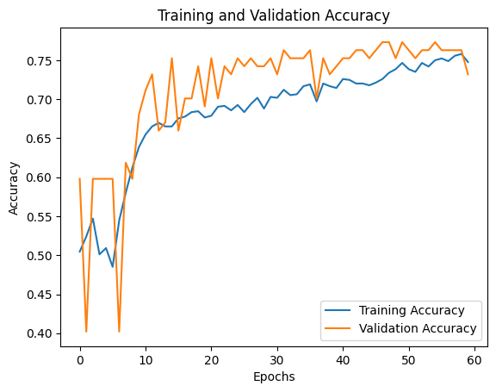
Overfitting(Variance threshold)
Notes:
Variance threshold
Then we have implemented feature selection using a variance threshold to eliminate irrelevant or redundant features from the dataset.
We did overcome the overfitting issue but couldn’t improve the performance of the model.
In machine learning, a variance threshold is a technique used to overcome overfitting, it is a technique where we would be setting a threshold on the variance of features, features with low variance (little variation in their values across samples) are removed from the dataset before training the model.

Slide 32
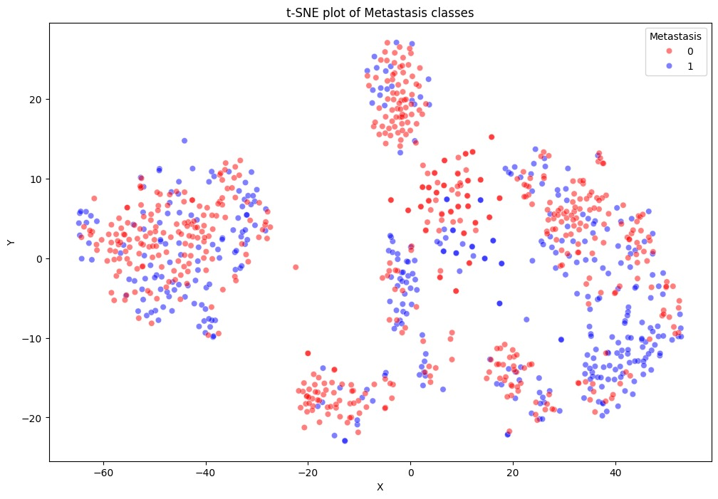
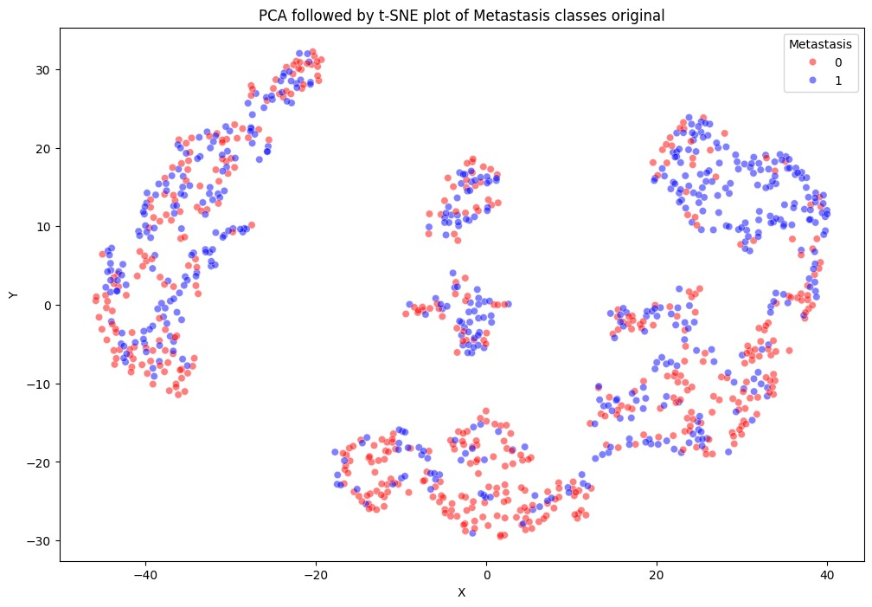
T-SNE & PCA
Notes:
We used dimensionality reduction techniques like TSNE & PCA to visualize the data and identify potential clusters or patterns that might be relevant to overfitting.
Through this plots we found that the classes are not separated properly.

Slide 33
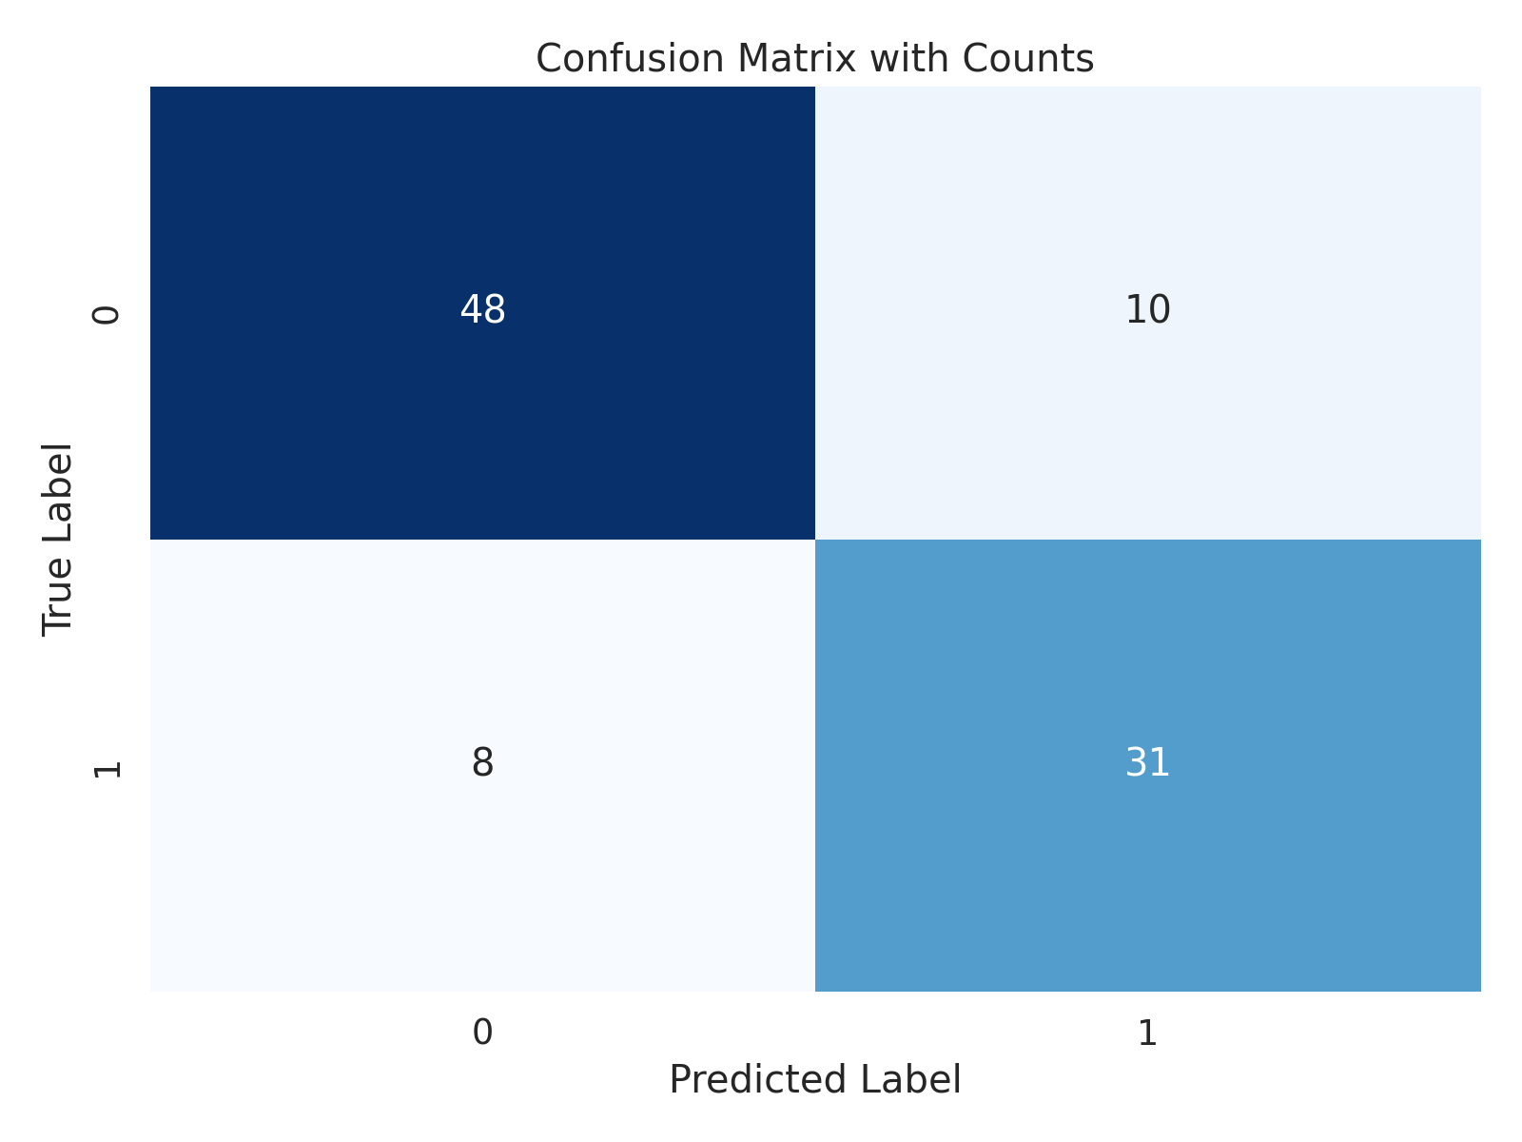
Confusion Matrix

Slide 34
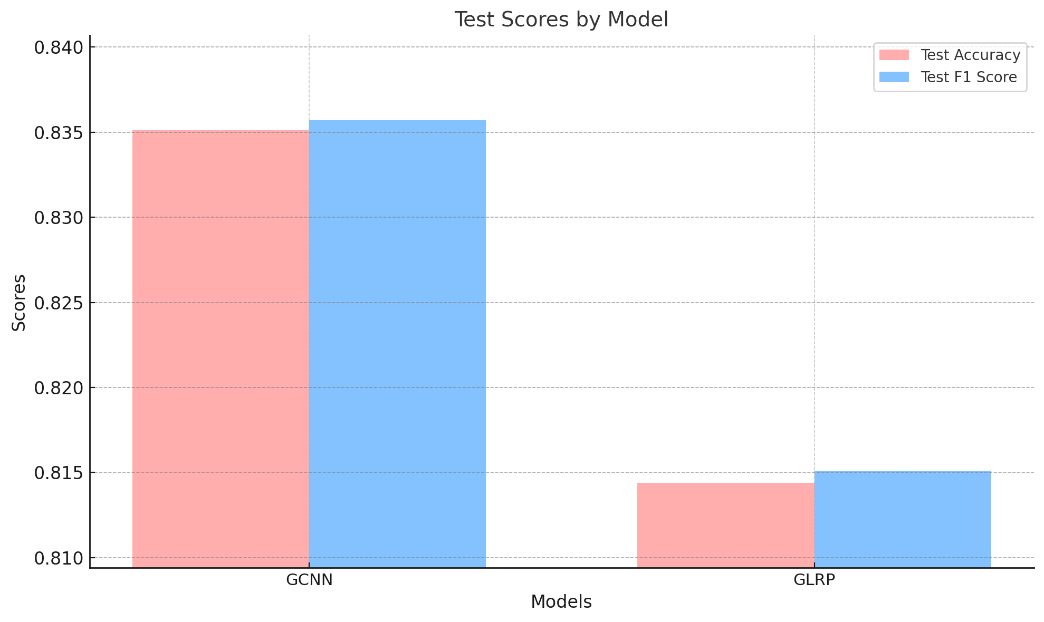
Test Scores

Slide 35
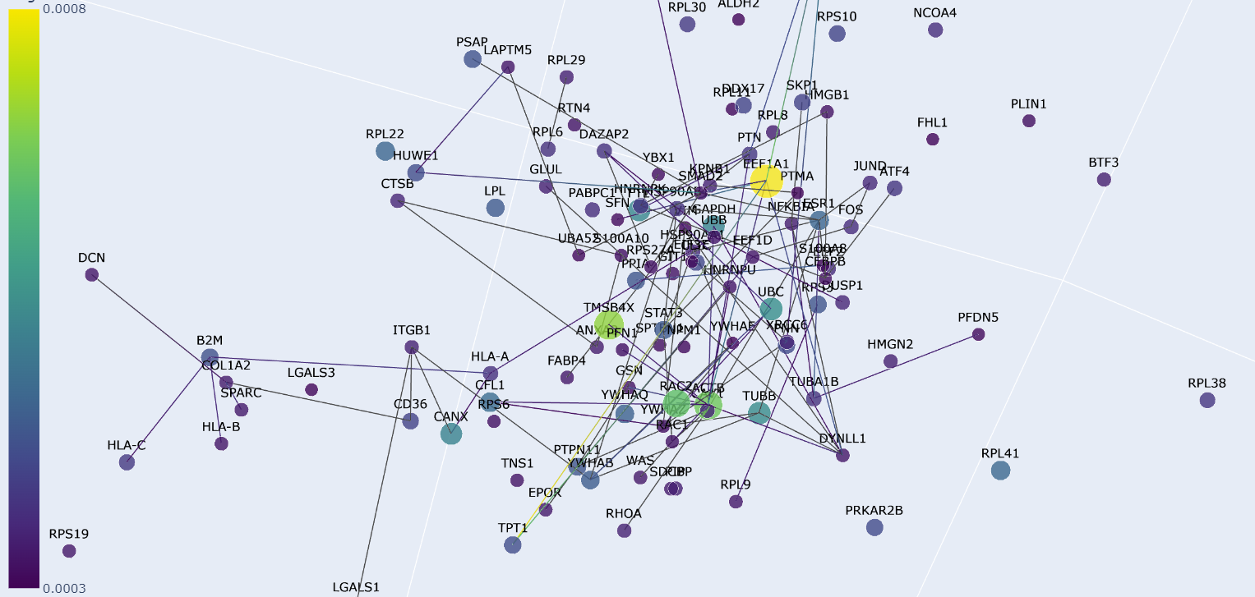
Sub Network

Slide 36
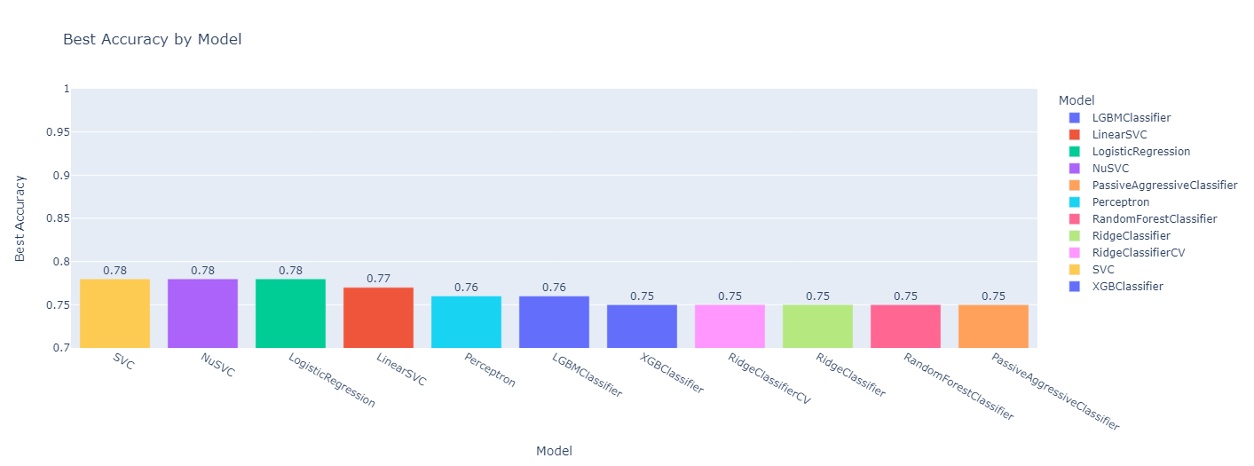
Lazy classifier

Slide 37
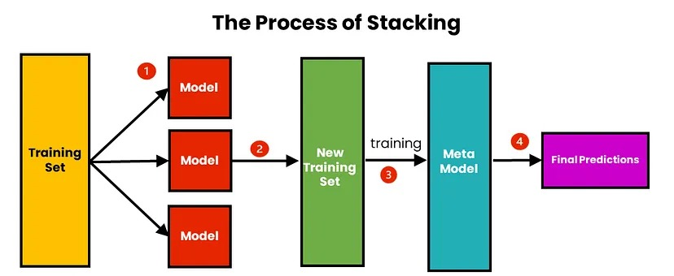
Stacked model
https://medium.com/@brijesh_soni/stacking-to-improve-model-performance-a-comprehensive-guide-on-ensemble-learning-in-python-9ed53c93ce28

Slide 38
Summary
Model | With Hyper Parameter Tuning | Without Hyper Parameter Tuning
GCNN | 83 | -
Stacked | 80.4 | 80
SVC | 79 | 78
Logistic Regression | 76 | 78
NuSVC | 79 | 78
Random Forest | 73 | 75
Lazy Classifier

Slide 39
Questions
If biomarker is previously discovered?
Any new biomarkers?
Model performance?
Future research

Slide 40
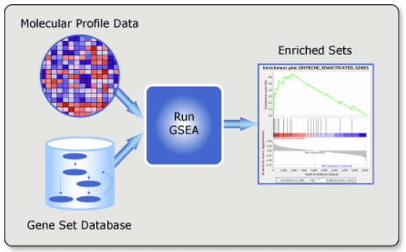
Gene Set Enrichment Analysis
https://www.gsea-msigdb.org/gsea/index.jsp

Slide 41
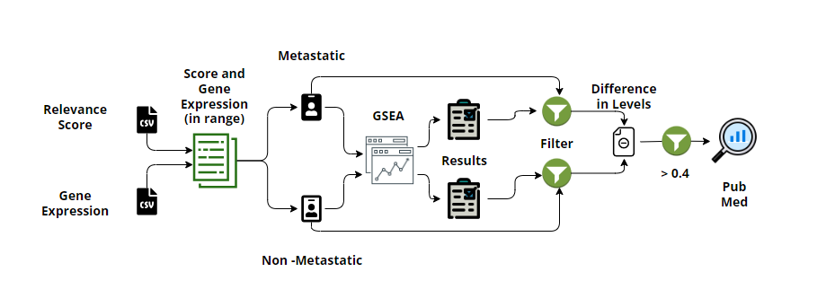
GSEA Pipeline

Slide 42
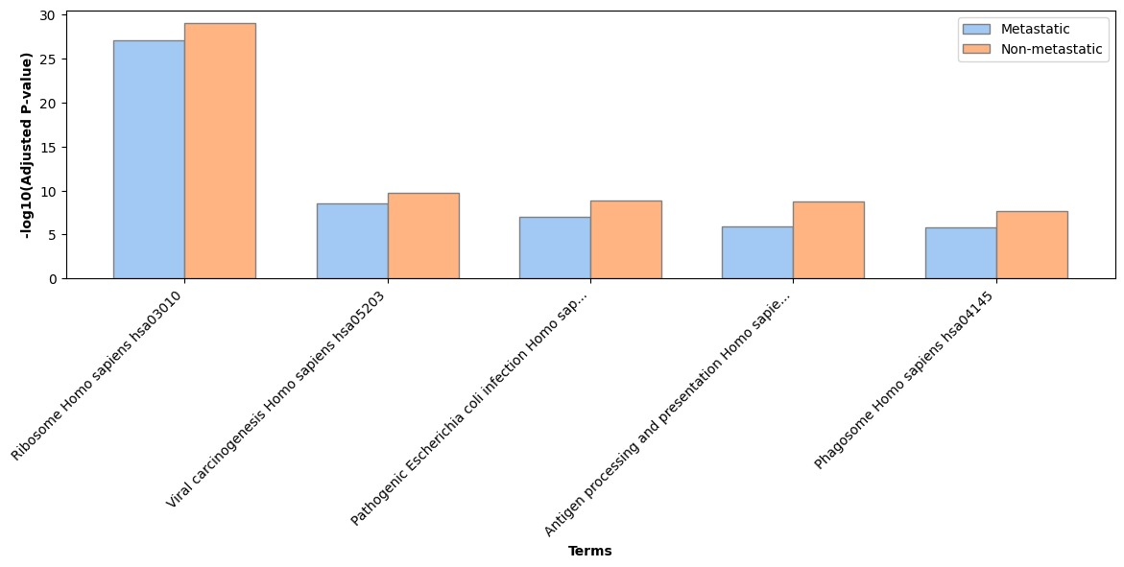
Reports - GSEA

Slide 43
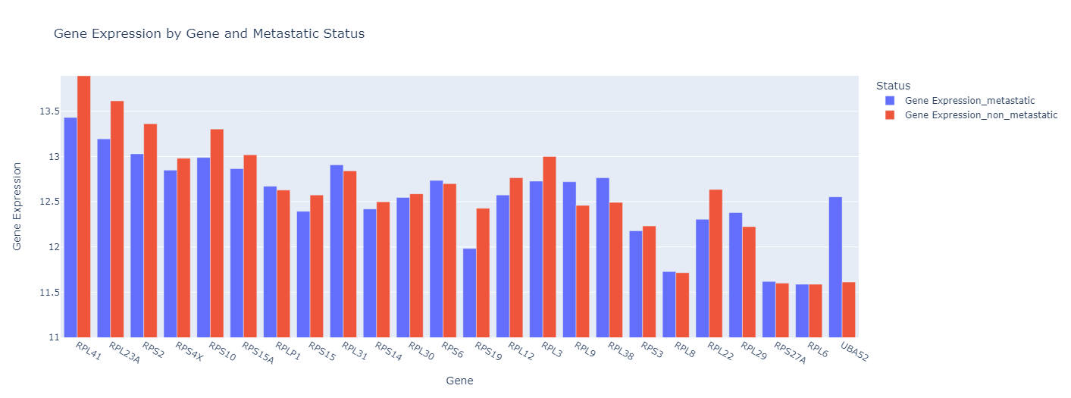
Results

Slide 44
Results
Ribosome Homo sapiens hsa03010 (25 genes overlap)
RPL41 - https://pubmed.ncbi.nlm.nih.gov/21706477/
RPL23A
RPS19 - https://pubmed.ncbi.nlm.nih.gov/29976410/
UBA52 - https://pubmed.ncbi.nlm.nih.gov/38445807/
RPL11 - https://pubmed.ncbi.nlm.nih.gov/36107539/

Slide 45
Results
Pathways in cancer Homo sapiens hsa05200 (325 genes overlap)
HSP90AA1- https://pubmed.ncbi.nlm.nih.gov/34109171/
RHOA - https://pubmed.ncbi.nlm.nih.gov/31705019/
RAC1 - https://pubmed.ncbi.nlm.nih.gov/35974143/
ITGB1 - https://pubmed.ncbi.nlm.nih.gov/31853313/
STAT1- https://pubmed.ncbi.nlm.nih.gov/35995341/

Slide 46
Conclusion
We used a GCNN to classify patients as metastatic or not. We explained the decision-making process with GLRP, identified biomarkers using GLRP relevance scores and GSEA, and validate them through PubMed.

Slide 47
Future research
Identify the cancer sub-type (PAM50)
Patient survival
Drug response
Individual gene significance

Slide 48
Abbreviations
GCNN : Graph Convolutional Neural Network
LRP : Layer-wise relevance propagation
CNV : Copy number variation
TCGA : The Cancer Genome Atlas
PPI : Protein-protein Interaction
GEO_HG : Gene expression omnibus(Human genome)
HPRD_PPI : Human Protein Reference Database(PPI)
PAM50 : Prediction Analysis of Microarray 50

Slide 49
Any Queries?

Slide 50
Thank You

